Slide 1

ONE MAN, FIREMAN
Studio Project Brothers

Slide 2
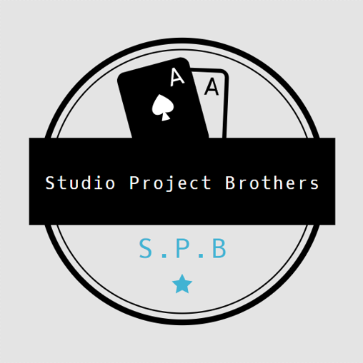
Studio Project Brothers
Matthew George Uy Ang
(Team Leader)
Chen Qing Bing
(Member)
Ling Guan Yu
(Member)
Liu Hao
(Member)

Slide 3
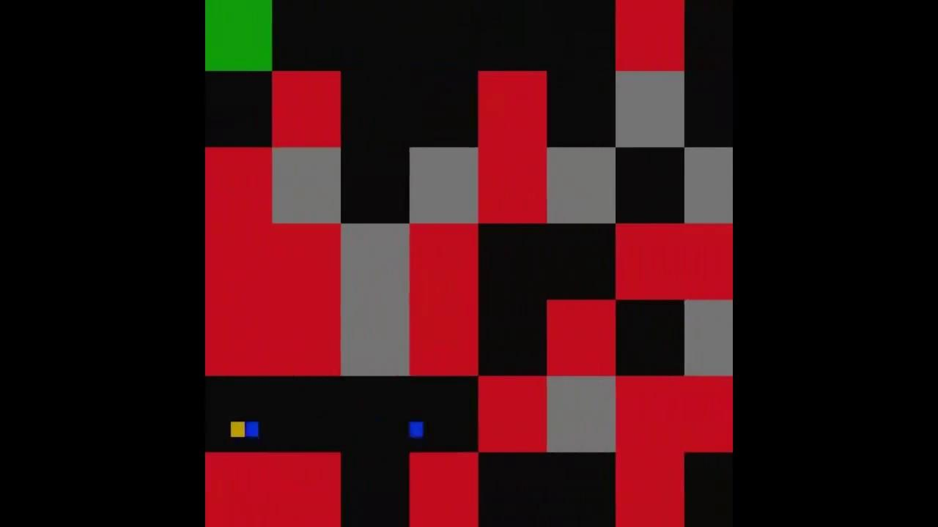
Trailer

Slide 4

Trailer

Slide 5

Game Idea / Concept

Slide 6
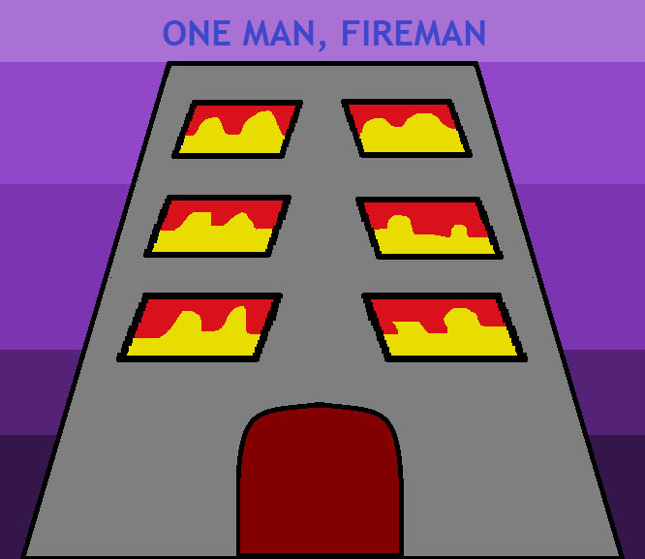
Top-down Auto Scroller
Play as a Fireman, navigating through a maze, whilst putting out fires to clear a path and saving civilians
Beat the boss at the end to complete the game, or challenge yourself with an Endless run
Game concept is inspired by Jetpack Joyride

Slide 7

Mechanics
Shooting of bullets
Saving of civilians
Smashing of Rubble (Walls)
Power-ups
Randomly Generated Map
Boss

Slide 8
Task Allocation

Slide 9

Tasks For Matthew:
Implement Auto-scrolling
Implementation of Random Map Generator
Autoscroll Collisions
Power-ups
UI (Highscores, Power-up)
Debugging

Slide 10
Tasks For Qing Bing:
Splash Screens
Main Menu
Options Menu
Helped in assembling Pitch Deck
Production Schedule
Debugging

Slide 11
Tasks For Guan Yu:
Helped in Boss Movement & Rendering of Boss Map
Conceptualised and Implemented Boss Rendering
Implemented Shooting and collisions for Boss
Implemented Bullets
Object Pooling
Debugging

Slide 12
Tasks For Liu Hao:
Conceptualisation of Pause Menu.
Help in implementation of Pause Menu.
Implementation of Sound in Main Menu.
Implementation of Sound in Game.
Help in implementation of Themes.
Help in implementation of Controls.
Help in implementation of Sound.

Slide 13

Learning Points / Challenges faced

Slide 14

Challenge 1:
Autoscroll was difficult due to codes for position and rendering being placed separately.
Solution/Learning Point:
We learned that by combining Position and Rendering together, we will be able to negate this issue from happening again.

Slide 15

Challenge 2:
We had trouble while compiling the code due to members having different file structures.
Solution/Learning Point:
We learned that it was important to come up with a basic structure that all the members worked with so that it will be easier for code compilation in the future.

Slide 16
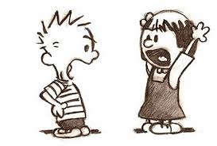
Challenge 3:
We had problems with communicating within the group due to members using a specific syntax that we were unable to understand.
Solution/Learning Point:
We learned that in order to maximise a team’s ability, we must set each other at a standardized level such that everyone will be able to contribute to the project to his or her best effort and lead the project to success.

Slide 17

Challenge 4:
We had problems implementing mouse detection for the console.
Solution/Learning Point:
We resorted to using button selection instead due to incapabilities of using mouse detection.
We learned that in order to do something more ambitious, we will need to more research in order to pull it of.

Slide 18

THANK YOU!
Studio Project Brothers

Slide 19

Q&A
Any questions?

